Slide 1

Introduction to language theory

Slide 2
Overview
What is a programming langue?
Interpreter
.NET Framework
.NET Application Execution
Types of programming languages
Go Lang
C++
Haskell
JavaScript

Slide 3
What is a programming language?
A programming language is a set of commands, instructions, and other syntax used to create a software program.
Languages that most programmers today use to write code are called "high-level languages“, this code can be compiled into a "low-level language“, which is recognized directly by the computer hardware.
Examples of high-level languages are C#, PHP and C++.
Example of low-level language is the assembly language.
High-level languages are designed to be easy to read and understand. This allows programmers to write source code in a natural fashion, using logical words and symbols.
High-level languages comes in two categories “compiled languages” and “interpreted languages”.
A compile langue is a language that needs to be translated into machine code in order to run on the CPU.
Examples of compiled languages are C# and Haskell.
A interpreted language does not need to be compiled because it can be run though an interpreter.
Examples of interpreted languages are PHP and Perl.

Slide 4
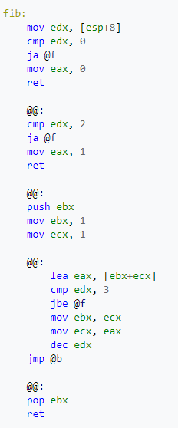

Example of Fibonacci number calculator in assembly language
Machine code output in a hexadecimal representation of a 32-bit x86.

Slide 5
Interpreter
A interpreter is a program that reads and executes code.
Source code
Pre-compiled code
Scripts
Interpreters are useful for running scripts and other small programs, because they can read and execute code in a single step.
The code can be changed and ran without the need of recompiling.
The limitations of a interpreted language is that an interpreter is needed to be installed on the machine, that want to execute the program.
Programs written in an interpreter may not be able to use built-in system functions or access hardware resources.
Therefore most software applications are compiled rather than interpreted.

Slide 6
Compiler
A compiler converts source code to into machine code, which can directly be run by the operating system and executed on the CPU.
This process is referred to as “compiling”.
Interpreters and compilers are similar, since they both recognize and process source code, but compilers are different because they do not execute code.
Compilers often allow you to target specific CPU architectures, to either add backward combability or to target newer architectures for better performance.
Compiled languages are often faster in execution, because they don’t need to be translated on startup.

Slide 7
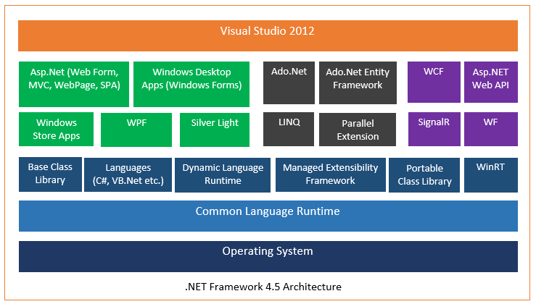
.NET Framework

Slide 8
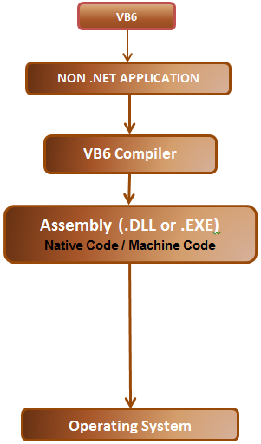
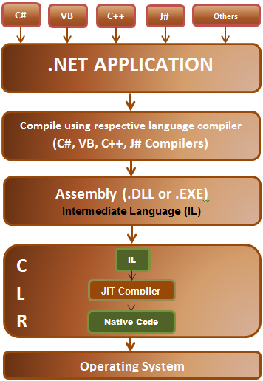
.NET Application Execution

Slide 9
.NET Application Execution
.NET assemblies contain IL (intermediate language), where as pre .NET assemblies contain native code (machine code).
.NET application executions consists of 2 steps.
Compilation – source code to IL.
Execution or JIT (just in time) compilation – IL to platform specific native code.
CLR - .NET runtime environment provides several benefits. Garbage collection is one of them.
.NET supports many different programming langauge and can only generate managed code (IL).
The native code is not stored permanently, after we close the program the native code is thrown away.

Slide 10

Go (Golang)
Procedural language.
Compiled.
Statically typed language.
Garbage collected.
Memory safe.
Created for better concurrent programming.
Closely inspired by Algol and C.
Created by Google in 2009.
Source code - https://github.com/golang/go

Slide 11
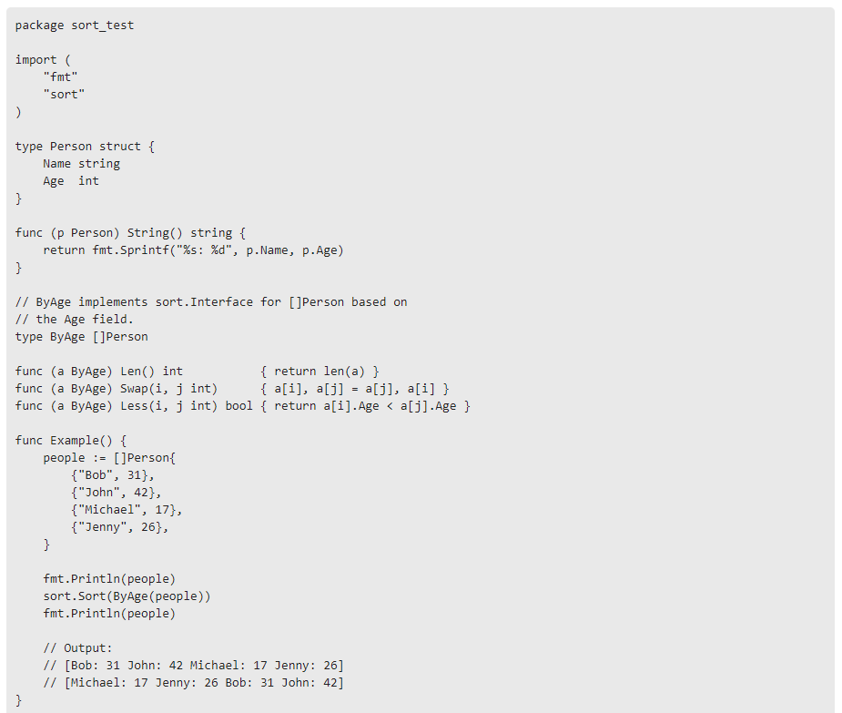
Go code example

Slide 12
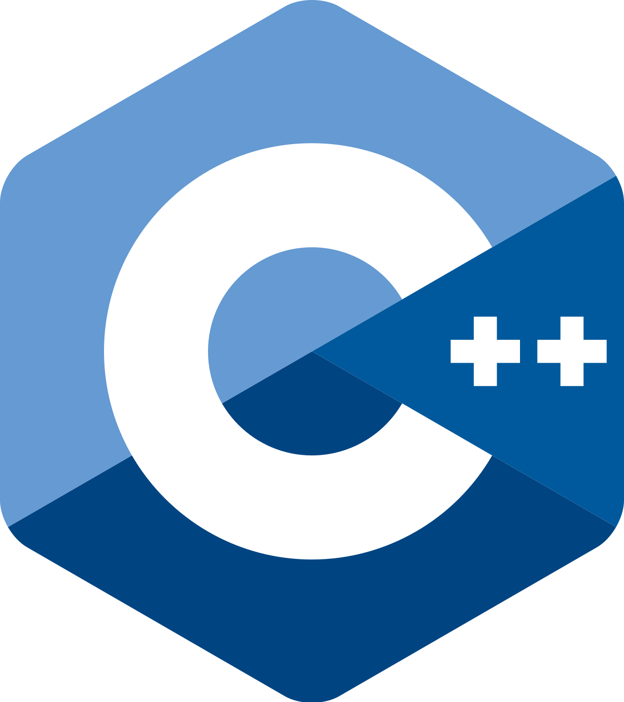
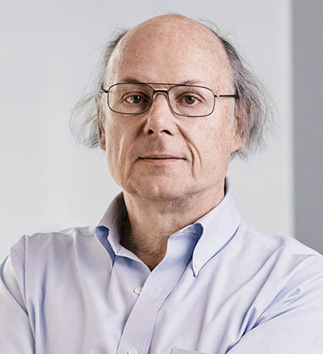
C++
Object oriented.
Compiled.
Statically typed language.
Allow low-level memory manipulation.
Used for performance critical applications (space probes, game engines, networking).
Not garbage collected.
Started development in 1979 by Bjarne Stroustrup.

Slide 13
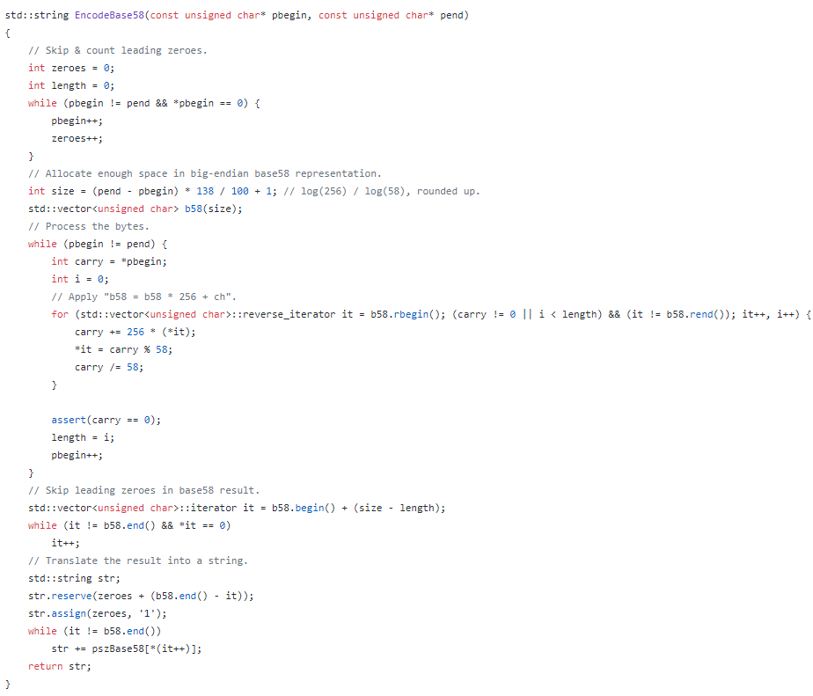
C++ code example

Slide 14

Haskell
Functional language.
Compiled language
Statically typed language.
Lazy evaluation.
Based on semantics instead of syntax.
Mainly used by “nerds” (academics).
Immutable.
Garbage collected.

Slide 15
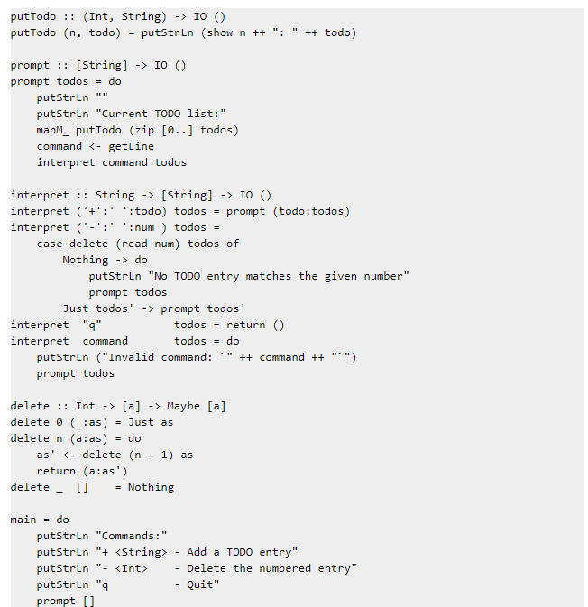
Haskell code example

Slide 16
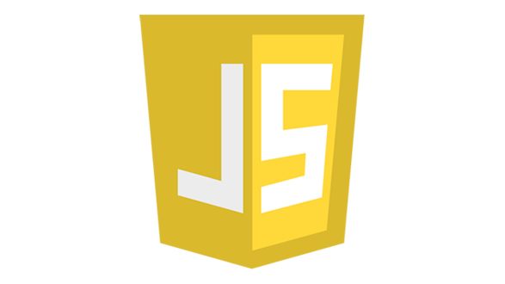
JavaScript
Interpreted language
Dynamic language (weakly typed)
Multi-paradigm language
Event driven
Functional
Object oriented
Often used in web-development, but is also very popular today for desktop and mobile applications.
Currently the most popular programming language.

Slide 17
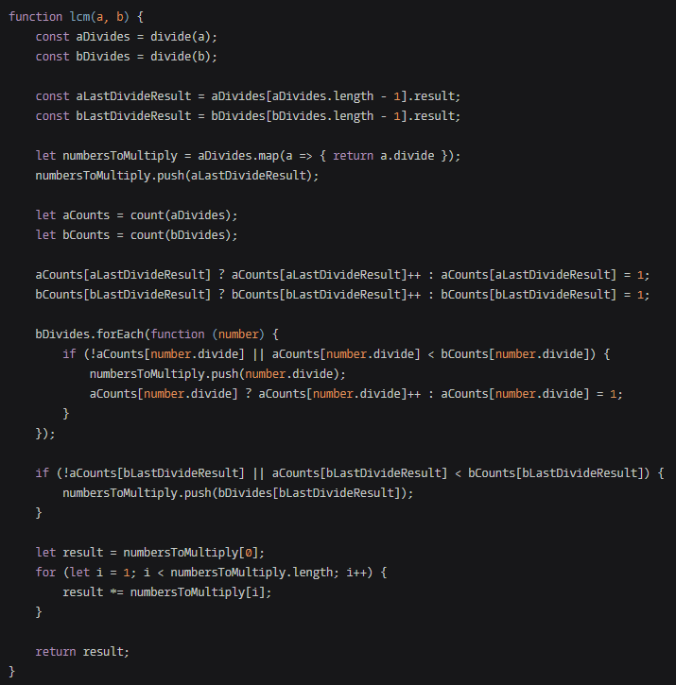
JavaScript code example

